Slide 1

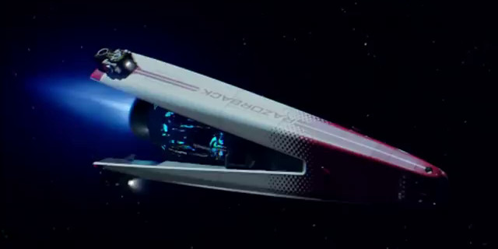

Razorback Marvel Site Introductions:
By Team Razorback:
Dylan Albers
Tyler Crabb
Bart Downey
Shawn Rogers

Slide 2


Highlights of This Sprint: Razorback Marvel Studios
Created a home page for our Marvel Studios Project - Shawn
Created a Series Page for our Marvel Studios Project - Bart
Created a Characters page for our Marvel Studios Project with a Characters carousel - Dylan
Created a Stan Lee tribute page for our Marvel Studios Project - Tyler

Slide 3
In Conclusion We -
Created a home page for our Marvel Studios Project
Created a Series Page for our Marvel Studios Project
Created a Characters page for our Marvel Studios Project with a Characters carousel
Created a Stan Lee tribute page for our Marvel Studios Project

Slide 4
Questions?

